Slide 1
PSY10120: Introduction to Psychological science
Dr Ondrej Zika
Lecture 1: Introduction to Psychology

Slide 2
Today's roadmap (50 minutes)
Module logistics (~15 min)
  coordinator, timetable, Brightspace, assessment, academic integrity
What is Psychological Science? (~30 min)
  five subfields of psychology, each illustrated with a classic study
Wrap-up (~5 min)
  recap, reading for next time, what's coming up

Slide 3
Module information

Slide 4
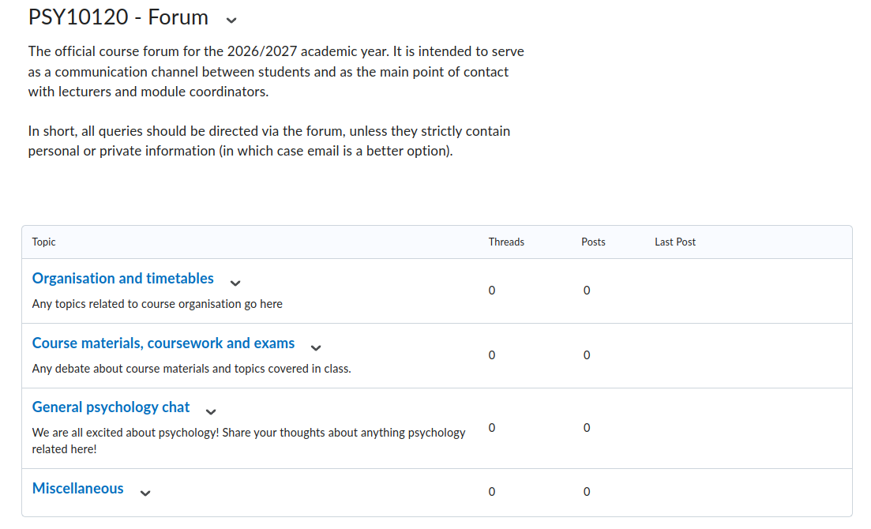
Meet the Team
Module Coordinator
  Dr Ondrej Zika
  Office: Newman Building, F203
  Office hours: By appointment only
  ondrej.zika@ucd.ie
Lecturers
  Christina Koretsidou
  Eden Bryan
  Pat Mulvaney
  Tobias Constein
  Julienne Debono
First point of contact is the Discussion Forum on Brightspace

Slide 5
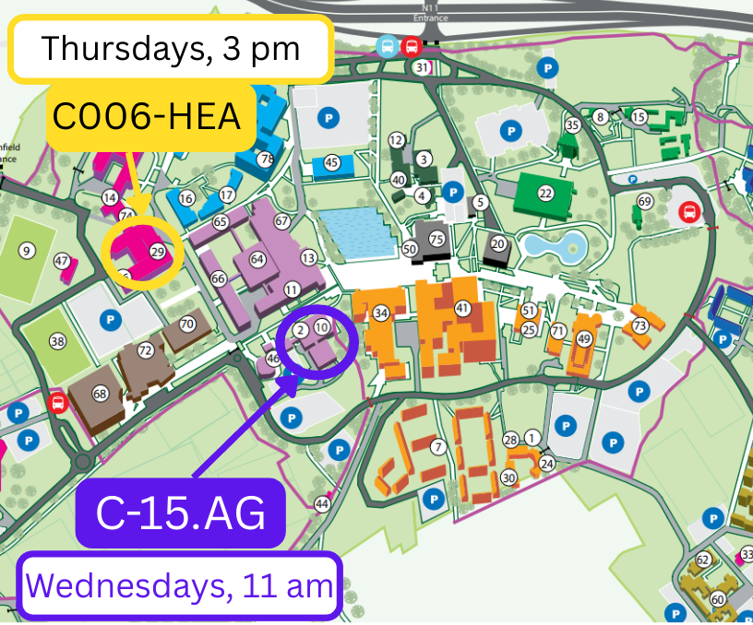
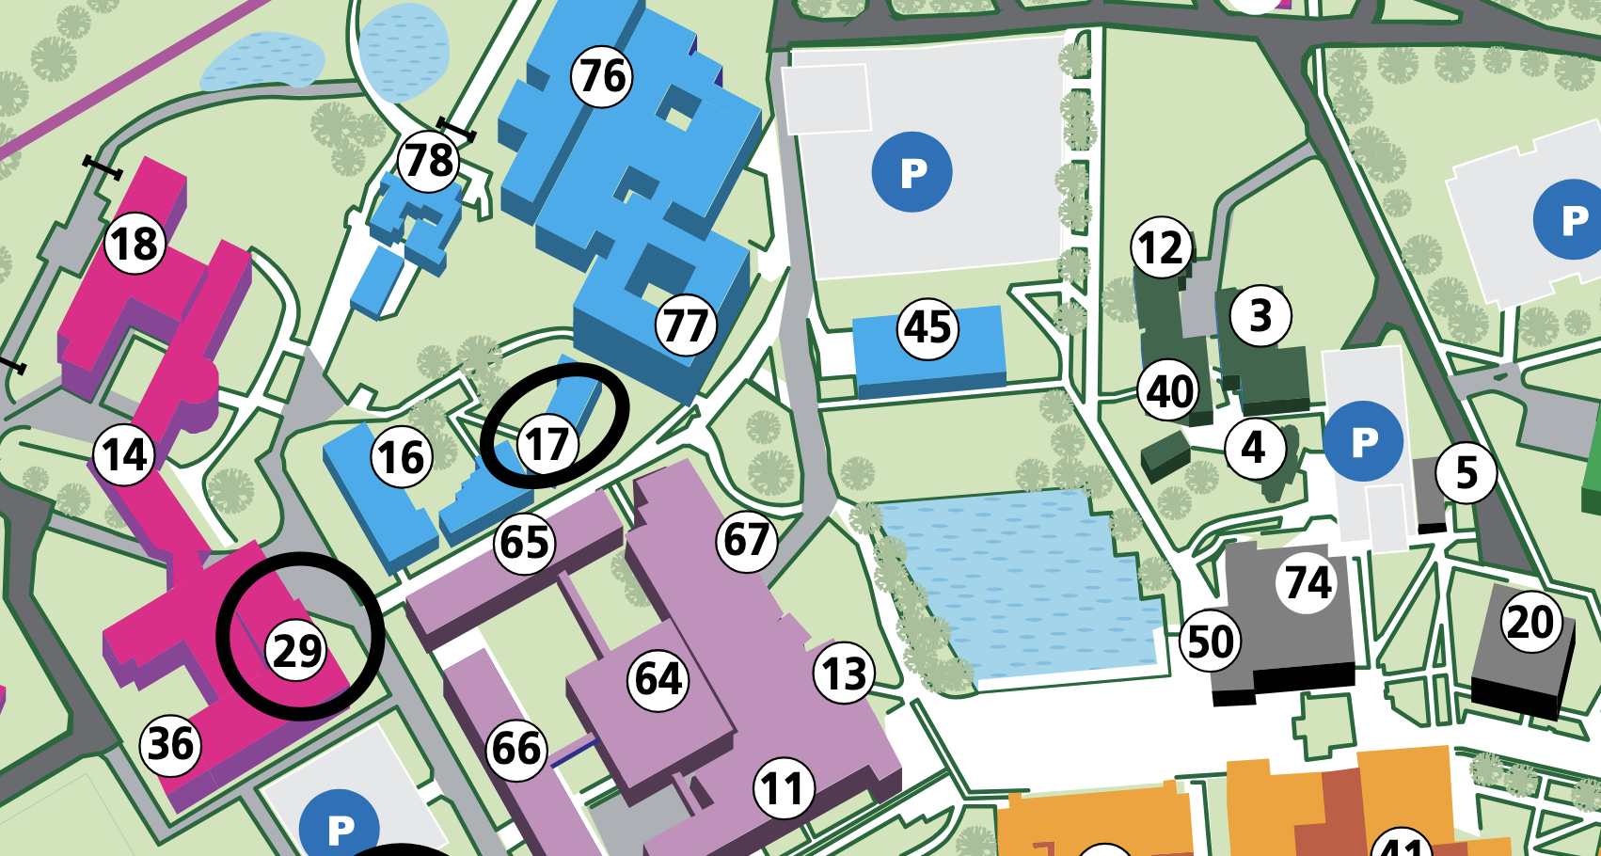
Class arrangements
Wed 11:00 — G-15.AG (157)
Thurs 15:00 — C006-HEA (110)

Slide 6
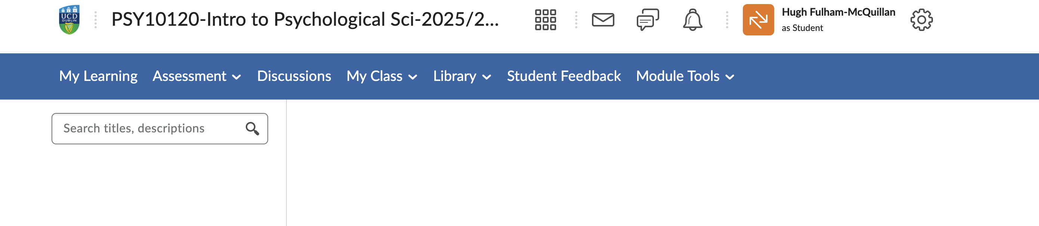
Brightspace
• All lecture slides, announcements, readings and the mid-trimester quiz are hosted on Brightspace
• Check the module homepage regularly for updates and messages from lecturers
• The Content area follows the same lecture-by-lecture structure as this schedule

Slide 7
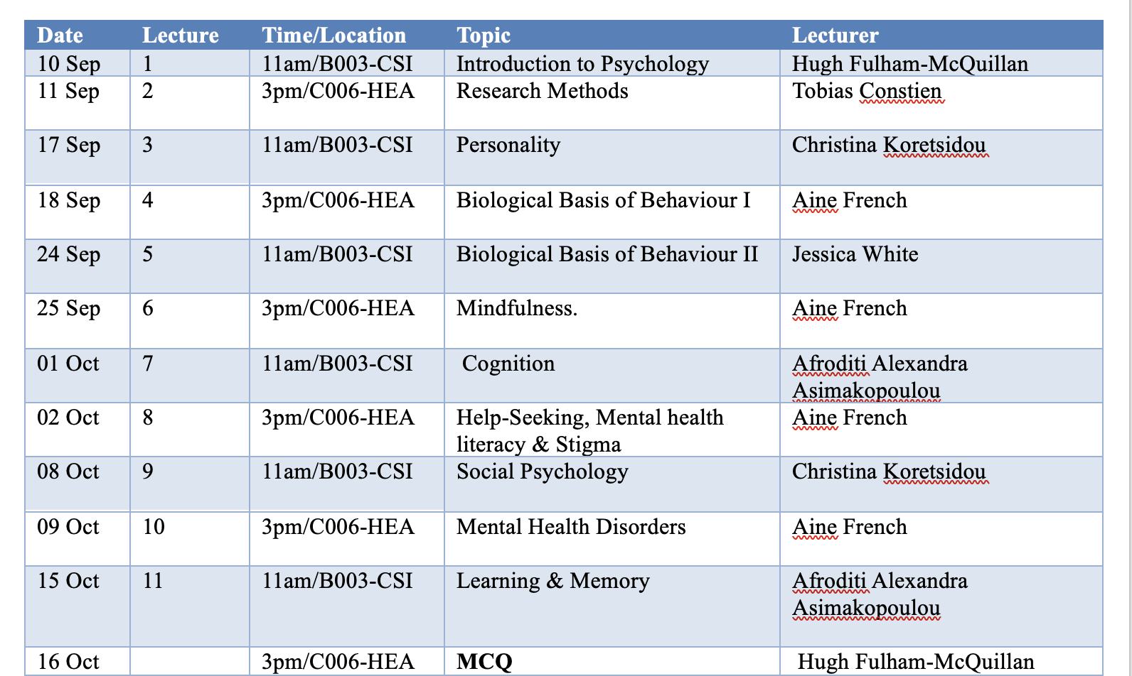
Lecture schedule
Date | Time | Room | Topic | Lecturer
09 Sep 2026 | 11:00 | G-15.AG (157) | Introduction to Psychology | Ondrej Zika
10 Sep 2026 | 15:00 | C006-HEA (110) | Research Methods | Tobias Constein
16 Sep 2026 | 11:00 | G-15.AG (157) | Personality | Eden Bryan
17 Sep 2026 | 15:00 | C006-HEA (110) | Biological Basis of Behaviour I | Eden Bryan
23 Sep 2026 | 11:00 | G-15.AG (157) | Biological Basis of Behaviour II | Pat Mulvaney
24 Sep 2026 | 15:00 | C006-HEA (110) | Mindfulness | Tobias Constein
30 Sep 2026 | 11:00 | G-15.AG (157) | Social Psychology | Christina Koretsidou
01 Oct 2026 | 15:00 | C006-HEA (110) | Help-Seeking, Mental health literacy & Stigma | Julienne Debono
07 Oct 2026 | 11:00 | G-15.AG (157) | Cognition | Julienne Debono
08 Oct 2026 | 15:00 | C006-HEA (110) | Mental Health Disorders | Julienne Debono
14 Oct 2026 | 11:00 | G-15.AG (157) | Learning & Memory | Tobias Constein
15 Oct 2026 | 15:00 | C006-HEA (110) | MCQ | Eden & Pat

Slide 8
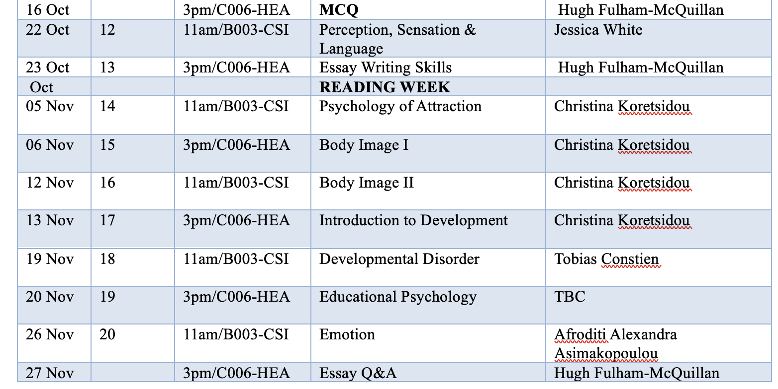
Lecture schedule
Date | Time | Room | Topic | Lecturer
21 Oct 2026 | 11:00 | G-15.AG (157) | Perception, Sensation & Language | Pat Mulvaney
22 Oct 2026 | 15:00 | C006-HEA (110) | Essay Writing Skills | Ondrej Zika
04 Nov 2026 | 11:00 | G-15.AG (157) | Psychology of Attraction | Christina Koretsidou
05 Nov 2026 | 15:00 | C006-HEA (110) | Body Image I | Eden Bryan
11 Nov 2026 | 11:00 | G-15.AG (157) | Body Image II | Eden Bryan
12 Nov 2026 | 15:00 | C006-HEA (110) | Introduction to Development | Tobias Constein
18 Nov 2026 | 11:00 | G-15.AG (157) | Developmental Disorder | Tobias Constein
19 Nov 2026 | 15:00 | C006-HEA (110) | Educational Psychology | Julienne Debono
25 Nov 2026 | 11:00 | G-15.AG (157) | Emotion | Pat Mulvaney
26 Nov 2026 | 15:00 | C006-HEA (110) | Essay Q&A | Ondrej Zika
07 Dec 2026, noon | — | — | Essay deadline | —

Slide 9

Learning outcomes
Understand, describe and evaluate the key scientific methods used by psychologists to gather data.
Identify, describe, compare and evaluate some of the major perspectives and theoretical approaches used in psychology.
Describe and evaluate how psychology may be applied to improve human functioning, well-being, learning, relationships and other activities.
Use core terminology and concepts central to psychological understandings of human thought, feelings and behaviour.

Slide 10

Reading
Individual lecturers will recommend readings in the relevant lectures
This can be supplemented by the corresponding chapters from Passer & Smith (2019)
  Or any introductory psychology book from the James Joyce library (shelfmark 150)
Independent reading is encouraged
Passer, M., & Smith, R. (2019). Psychology: The science of mind and behavior (4th ed). New York: McGraw-Hill.

Slide 11
Other resources
As well as journal articles and books, there are lots of more informal sources of interesting info about social psychology
Blogs
  BPS Research Digest: https://www.bps.org.uk/collections/research-digest
  (old but good) Mind Hacks: https://mindhacks.com/
Social media
  @UCDPsychology
Podcasts
  All in the Mind: https://www.bbc.co.uk/programmes/b006qxx9
  Invisibilia: https://www.npr.org/podcasts/510307/invisibilia
  Hidden Brain: https://www.npr.org/series/423302056/hidden-brain
  Opinion Science: https://opinionsciencepodcast.com/
  BBC–The Science of Evil: https://www.bbc.co.uk/programmes/m000drbx

Slide 12
Assessment 1: MCQ (50%)
MCQ test
15 Oct 3pm
Will assess topics covered in lectures 1-11
Taken in class
On own device
Practice test will be available beforehand
30 questions
4 answer options
30 minutes
No negative marking

Slide 13
Assessment 2: Essay Assignment (50%)
Deadline: 7th Dec. at noon
Length: 1,000 words (+/- 10%) excluding References section
Details will be posted in week 8, including grading rubric

Slide 14

Academic integrity
Plagiarism is a serious offence
  Plagiarism is the inclusion, in any form of assessment, of material without due acknowledgement of its original source.
  All assignments will be automatically screened by the Turnitin plagiarism detector, and the reports will be reviewed by the module coordinator
  Suspected cases of plagiarism are referred to the School of Psychology Academic Integrity Committee, and may result in serious penalties
  Avoid plagiarism by making sure your assignments are written in your own words, and that you have correctly cited all your sources, using APA standards
  Visit https://libguides.ucd.ie/academicintegrity for guidance on how to avoid plagiarism and other forms of academic misconduct
Please note that the use of generative AI tools (e.g. ChatGPT, Google Bard etc.) is NOT permitted in the assessments for this module.

Slide 15
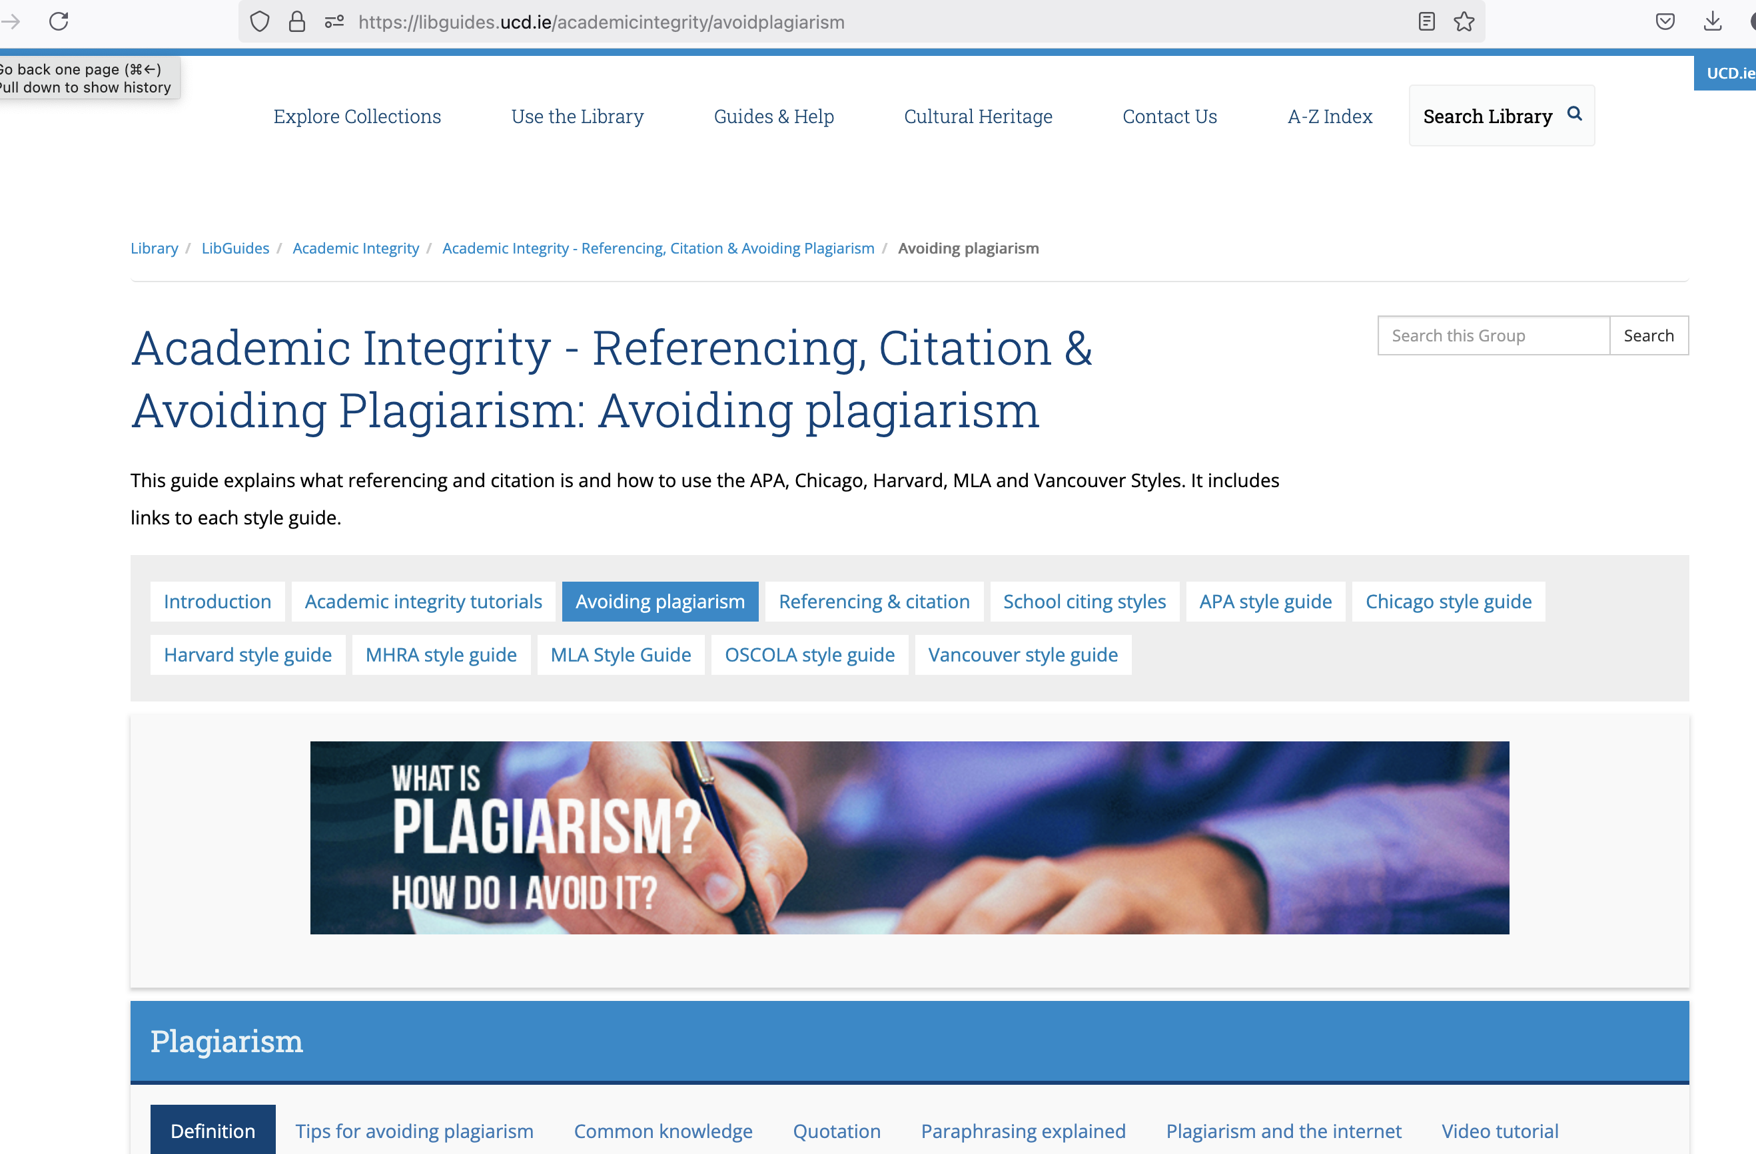

Slide 16
Introducing psychological Science

Slide 17

What made you choose this module?
What interests you about psychology?

Slide 18
What is psychology?
Psychology is the scientific study of human thought and behaviour
Composed of several different subfields:
  Cognitive psychology
  Biological psychology
  Social psychology
  Developmental psychology
  Personality & individual differences
  Computational psychology & neuroscience
Notes:
Behaviour: refers to actions and responses that we can directly observe
Mind: refers to internal states and processes such as thoughts and feelings that cannot be
seen directly and must be inferred from observable measurable responses

Slide 19
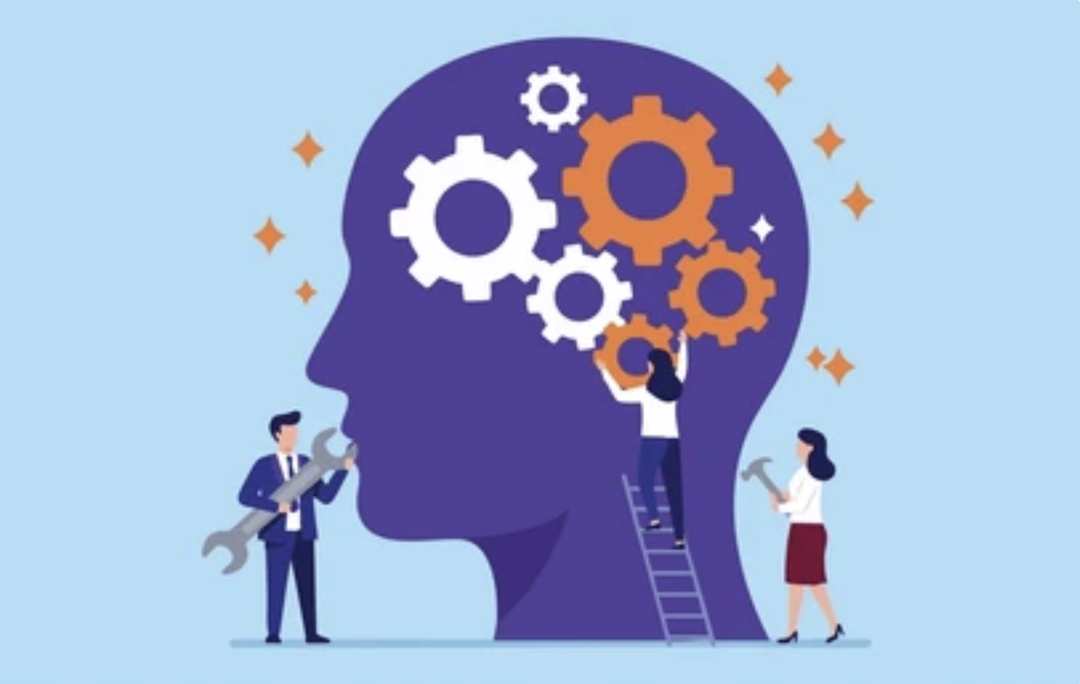
Cognitive Psychology
The scientific study of mental processes
This includes concepts, perception, memory, emotion and reasoning
What does the mind do and what are its limits?
Cognitive psychologists often draw on ideas from computer science and neuroscience

Slide 20
Computational Psychology & Neuroscience
Uses computational models and simulations to understand how the mind and brain process information
Bridges cognitive psychology (the “software” of thought) and biological psychology (the “hardware” of the brain)
Draws on statistics, computer science and machine learning to model neural activity and behaviour
Growing applications include computational psychiatry, brain-computer interfaces, and AI-inspired models of learning and memory

Slide 21
Example of a classic cognitive study
Framing of risk (Tversky & Kahneman, 1981)
Imagine 600 people are affected by a deadly disease. There is a treatment, but it is risky…
There is a 33% chance of saving all 600 people, 66% probability of saving no one
  Vs.
There is a 66% probability that all 600 will die, 33% chance that no one will die
72% of people who saw the first frame would approve the treatment, whereas only 22% who saw the second would
Tversky, A., & Kahneman, D. (1981). The framing of decisions and the psychology of choice. Science, 211(4481), 453-458.

Slide 22
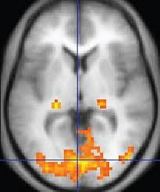
Biological Psychology
Behavioural neuroscience studies the biological underpinnings of thought, emotion and behaviour
Involves many biological structures/processes, including:
  Brain regions
  Neurochemicals
  Genes
  Even the immune system!
Greatly advanced in recent years with development of brain imaging technology e.g. fMRI

Slide 23
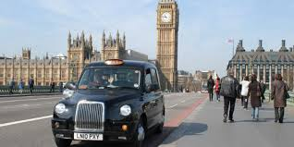
Example of a classic neuroscientific study
Hippocampi of London taxi-drivers (Maguire et al., 2000)
Taxi-drivers have highly developed visuospatial memory
The hippocampus is a brain region involved in memory
Maguire et al. (2000) showed that experienced taxi-drivers had larger hippocampi than novice or non-drivers
Key demonstration of neuroplasticity: the brain’s ability to change with experience
Maguire, E. A., Gadian, D. G., Johnsrude, I. S., Good, C. D., Ashburner, J., Frackowiak, R. S., & Frith, C. D. (2000). Navigation-related structural change in the hippocampi of taxi drivers. Proceedings of the National Academy of Sciences, 97(8), 4398-4403.

Slide 24

Social psychology
The scientific study of how people think, feel and act
in relation to each other
Topics like relationships, identity, attitudes and prejudice
We do not exist as isolated individuals - we learn from and are influenced by other people
Social psychology experiments often investigate how behaviour changes depending on the social context they’re in

Slide 25

Example of a classic social study
Minimal group studies (Tajfel, 1970)
Strangers divided into groups on random basis (e.g. coin toss)
Asked participants to divide money between themselves
Give more to ‘ingroup’ members, even though groups are entirely arbitrary
Prefer distribution where their group has the highest relative advantage, even if that means they get less money overall (e.g. €7:1 vs €12:11)
Tajfel, H. (1970). Experiments in intergroup discrimination. Scientific American, 223, 96-102

Slide 26

Developmental Psychology
The study of how cognition, emotion and behaviour change over the lifespan
How do early life experiences influence adult outcomes?
Nature vs. nurture: How do biological inheritance and social experience interact to produce the people we become?
Traditionally concerned with infants and children, but recent increase in interest in later life

Slide 27
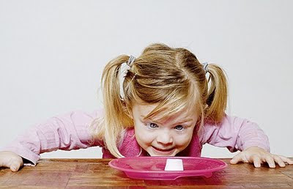
Example of a classic developmental study
Delayed gratification (Mischel & Baker, 1975)
Definition of self-control: ability to forgo a small immediate reward to obtain a larger future reward
Marshmallow experiment:
https://www.youtube.com/watch?v=QX_oy9614HQ
Children succeed through cognitive strategies (e.g. distraction)
Early delayed gratification ability predicts academic, career and personal success in later life
Mischel, W., & Baker, N. (1975). Cognitive appraisals and transformations in delay behavior. Journal of Personality and Social Psychology, 31(2), 254.

Slide 28
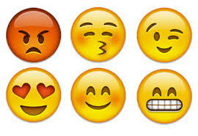
Personality & Individual Differences
Most psychology investigates things people have in common - the study of individual differences focuses on how people differ
Personality = “an individual’s characteristic pattern of thought, emotion, and behaviour, together with the psychological mechanisms – hidden or not – behind those patterns” (Funder, 1997)
Intelligence = “the aggregate or global capacity of the individual to act purposefully, to think rationally and to deal effectively with his environment” (Wechsler, 1940)
Funder, D.C. (1997). The personality puzzle. New York: W.W. Norton.

Slide 29
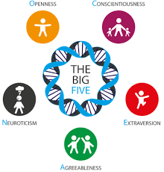
Example of a classic personality study
The Big Five (McCrae & Costa, 1987)
Factor analysis of self-rated personality data suggests personality is composed of 5 key dimensions
    Openness, Conscientiousness,
    Extraversion, Agreeableness, Neuroticism
    Mnemonic: OCEAN
Most of an individual’s personality can be captured by where they fall on these 5 dimensions
McCrae, R. R., & Costa, P. T. (1987). Validation of the five-factor model of personality across instruments and observers. Journal of Personality and Social Psychology, 52(1), 81.

Slide 30

Applying psychological knowledge
These approaches to studying thought, emotion and behaviour can all be applied to understand and change real-world contexts
  Each approach gives a different perspective on any given phenomenon
Applied psychology fields include:
  Clinical psychology, counselling psychology, health psychology, educational psychology, forensic psychology, organisational psychology

Slide 31
Reading
Read 1st chapter of Passer & Smith (2019)
  Or any introductory psychology textbook - lots in library (James Joyce 150) and online PDFs/Google Books
Next lecture: Research Methods with Tobias Constein
Questions about module structure/assessment ondrej.zika@ucd.ie

